Slide 1

Lecture 3 Classification Sadaf Iqbal & Muhammad Suleman

Slide 2
Lecture Outline
11-11:59 AM – Logistic Regression
12:00-12:15 AM – Break
12:15-1:15 AM – GLM and PCA
1:15-1:30 PM – Break
1:30-2:30 AM – Feature Engineering

Slide 3
Machine Learning Vocabulary
Logistic Regression - Classification
Classes – Labels
Binary Classification
Cross Entropy Cost Function
Sigmoid Function / Logistic Function

Slide 4
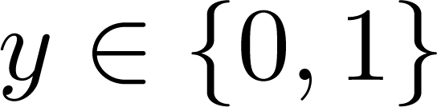
Classification
Email: Spam / Not Spam?
Online Transactions: Fraudulent (Yes / No)?
Tumor: Malignant / Benign ?
0: “Negative Class” (e.g., benign tumor)
1: “Positive Class” (e.g., malignant tumor)

Slide 5

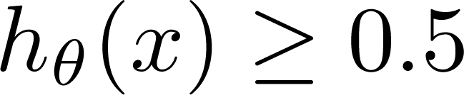
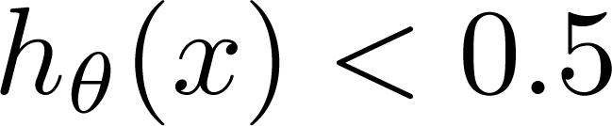
(Yes) 1
Malignant ?
(No) 0
Tumor Size
Tumor Size
Threshold classifier output at 0.5:
If , predict “y = 1”
If , predict “y = 0”

Slide 6
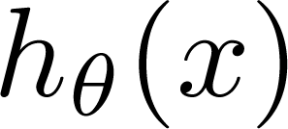
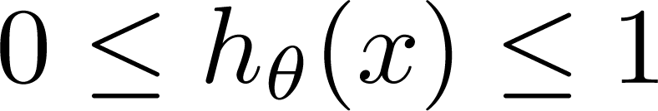
Classification: y = 0 or 1
can be > 1 or < 0
Logistic Regression:

Slide 7
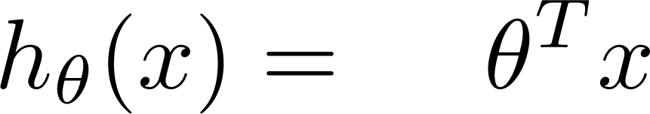
Logistic Regression Model
Want
1
0.5
Sigmoid function
Logistic function
0

Slide 8

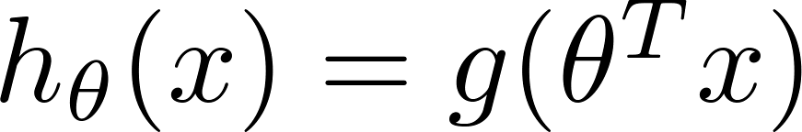
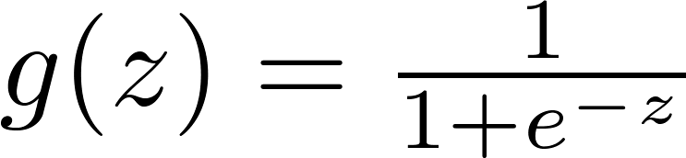

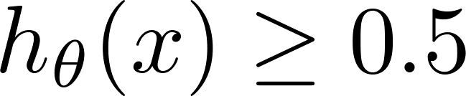

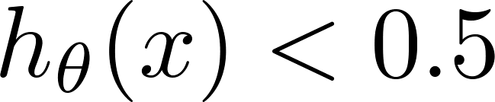
Logistic regression
1
z
Suppose predict “ “ if
predict “ “ if

Slide 9
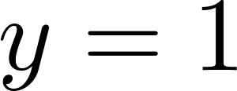

How to fit (find) Parameter θ Parameter θ (θ0, θ1, θ2) defines the decision boundary not the training set. Training set may be used to find the Parameter θ
Decision Boundary
x₂
3
2
1
1
2
3
x₁
Predict “ “ if

Slide 10
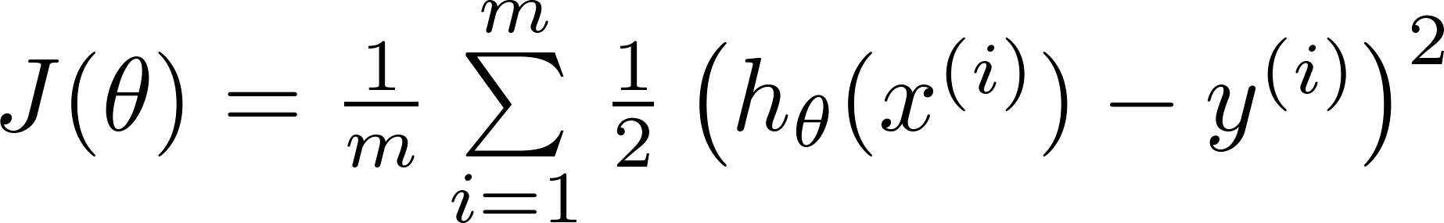


J(θ) is non-linear beacause of the
presence of non-linear sigmoid function
Cost function
Linear regression:
Non-Linear
Function
“non-convex”
“convex”
We want J(θ) to
behave like this

Slide 11
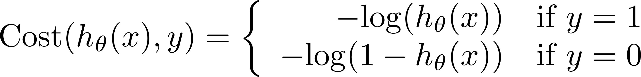
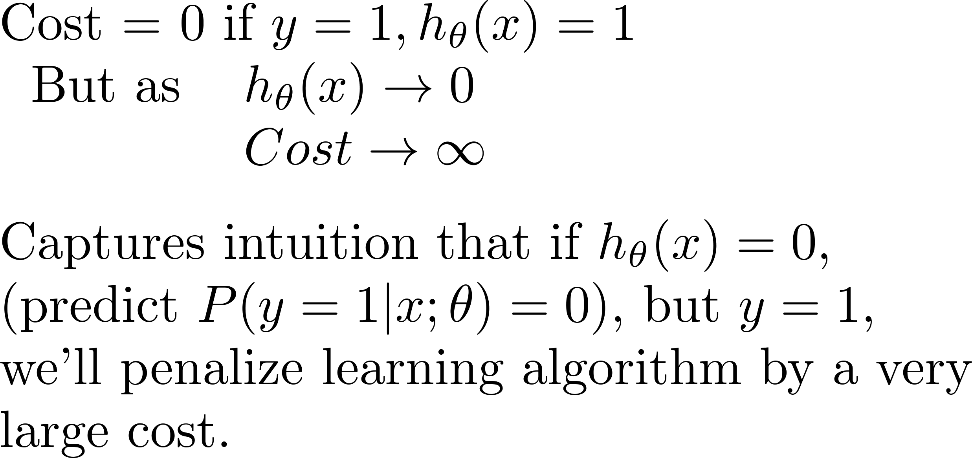
Logistic regression cost function
Different
Cost Function
If y = 1
0
1

Slide 12
Logistic regression cost function
If y = 0
0
1

Slide 13
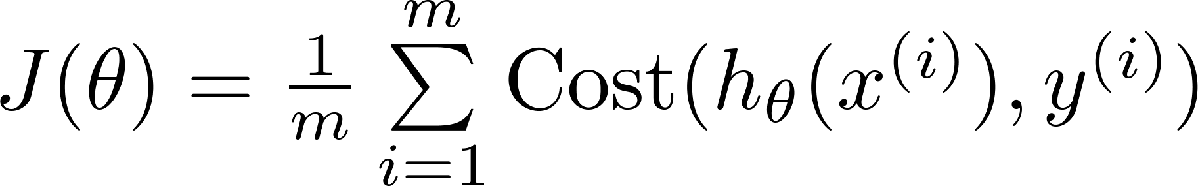
Logistic regression cost function

Slide 14

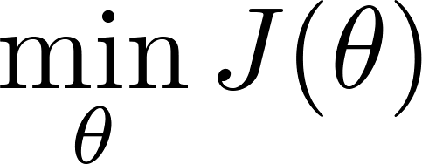

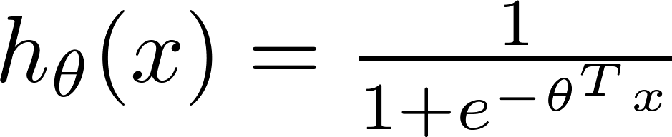
Logistic regression cost function
To fit parameters :
To make a prediction given new :
Output

